Slide 1
Requirements Analysis-I

Slide 2
Requirements Analysis
It must be possible to test each requirement (Testability).
Categorization and prioritization of all requirements.

Slide 3
Prioritizing (Ranking) Use Cases
Strategy :
  pick the use cases that significantly influence the core architecture
pick the use cases that are critical to the success of the business.
a useful rule of thumb - pick the use cases that are of highest risk!!!

Slide 4
Requirements Analysis
Completeness
    Self contained, no omissions.
Error conditions
  State what happens in case of an error. How should the implementation react in case of an error condition?

Slide 5
Consistency of Requirements
Different requirements must be consistent.
    Example:
    R1.2: The speed of the vehicle will never exceed 250 mph.
    R5.4: When the vehicle is traveling at a speed greater than 300 mph, a special “supervisory body” safety mechanism will be automatically activated.

Slide 6
Requirements Development Process
1. Define the project's vision and scope
2. Identify user classes
3. Identify appropriate representatives from each user class
4. Identify and document the hierarchy of users (for requirements decision-making process)
5. Select and plan requirements elicitation techniques
6. Apply the elicitation techniques to develop and prioritize the main use cases for the system (architecturally significant use cases). One approach is to identify all use cases but detail those with the highest priority first.

Slide 7
Requirements Development Process
7. Identify quality attributes, other non-functional requirements and constraints
8. Develop functional requirements from use cases.
9. Develop analysis models as needed to clarify problem domain and/or requirements
10. Optionally develop prototype to verify requirements with end users

Slide 8
System modelling
System modelling helps the analyst to understand the functionality of the system and models are used to communicate with customers
Different models present the system from different perspectives
  External perspective showing the system’s context within the environment
  Behavioural perspective showing the behaviour of the system (how it performs various activities)
  Structural perspective showing the system architecture and/or data architecture

Slide 9
System modelling …
Structured methods incorporate system modelling as an inherent part of the method
Methods define a set of models, a process for deriving these models and rules and guidelines that should apply to the models
CASE tools support system modelling as part of a structured method
System Models : Abstract descriptions of systems whose requirements are being analysed

Slide 10
Model types
Data processing model showing how the data is processed at different stages
Composition model showing how entities are composed of other entities
Architectural model showing principal sub-systems
Classification model showing how entities have common characteristics
Response model showing the system’s reaction to events

Slide 11
Key Definition
Decomposition is the process of modeling the system and its components in increasing levels of detail.
Balancing involves insuring that information presented at one level of a DFD is accurately represented in the next level DFD.

Slide 12
What are Data Flow Diagrams?
Data flow diagrams illustrate how data is processed by a system in terms of inputs and outputs.
Data Flow Modeling represents the flow of information around a system, the way it is changed and stored and the 'sources' and 'sinks' of information outside the system.
DFDs show how information flows around a system, they:
  represent a situation (scenario) from the viewpoint of the data (it’s flow);
  are a technique to analyze the processes in the system from most abstract level to most detailed level.

Slide 13
Data Flow Diagrams
The purpose and value of the data flow diagram is primarily data discovery within the environment, not process mapping - hence the name "data flow diagram" (DFD).
Data Flow Diagrams (DFDs) take a 'top-down' approach, expanding the system description into more and more detail via a series of 'levels', so a set of DFDs will comprise a Context Diagram (Level 0 DFD), a Level 1 DFD, and perhaps some Level 2 DFDs, (one for each complicated Process at Level 1).

Slide 14
Data Flow Diagrams : Objectives
to graphically document boundaries of a system;
to provide hierarchical division/breakdown of the system;
to show movement of information between a system and its environment;
to document information flows within the system;
to aid communication between users and analysts, analysts and designers, designers and developers, developers and testers etc.

Slide 15

Data Flow Diagram Notations
Process
A process transforms incoming data flow into outgoing data flow
Process Notation

Slide 16


Data Flow Diagram Notations
DataStore : Datastores are repositories of data in the system. They are sometimes also referred to as files.
Datastore Notations

Slide 17
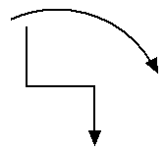
Data Flow Diagram Notations
Dataflow : Dataflows are lines through which packets of information flow. Label the arrows with the name of the data that moves through it.

Slide 18

Data Flow Diagram Notations
External Entity External entities are objects outside the system, with which the system communicates. External entities are sources and destinations of the system's inputs and outputs.

Slide 19
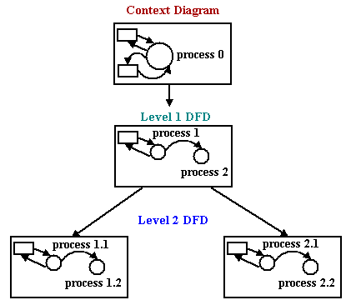
Data Flow Diagram Layers

Slide 20
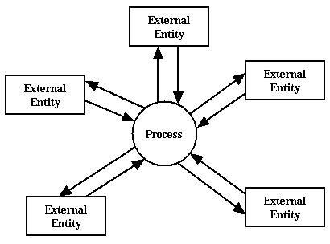
Context Diagrams
A context diagram is a top level (also known as Level 0) data flow diagram. It only contains one process node (process 0) that generalizes the function of the entire system in relationship to external entities.

Slide 21
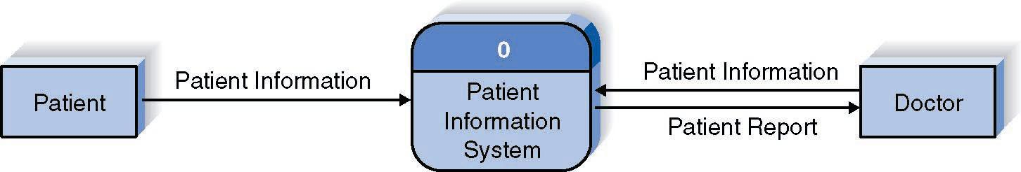
Example( Context Level DFD):

Slide 22
Context Diagram…
Shows the context in which the business process exists
Shows the overall business process as just one process
Shows all the outside entities that receive information from or contribute information to the system
No Data Stores

Slide 23
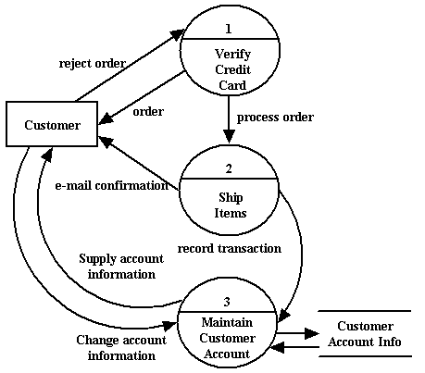
DFD levels
The first level DFD shows the main processes within the system. Each of these processes can be broken into further processes until you reach pseudo-code.
(for example Online shopping system)

Slide 24
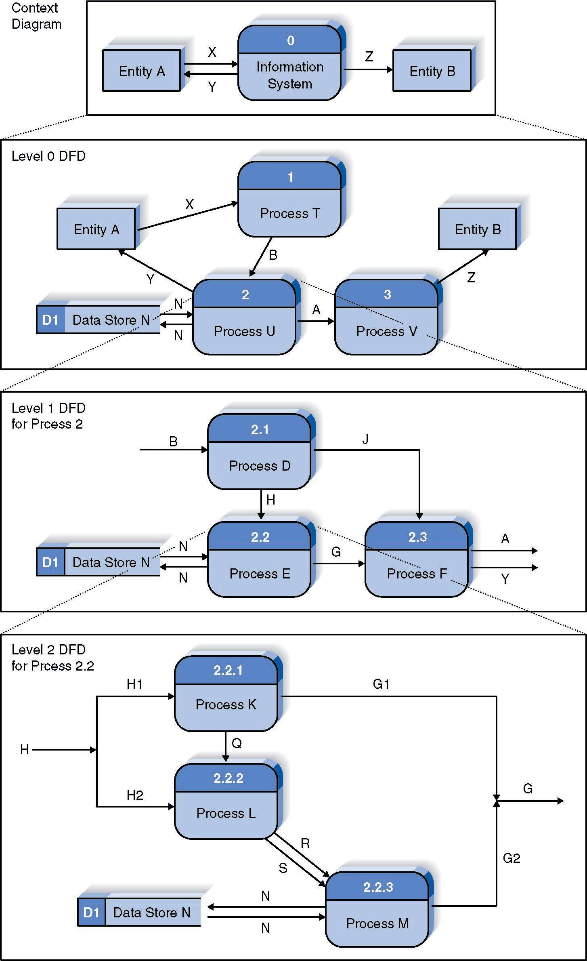
Relationship Among DFD levels

Slide 25
Level 1 Diagram
Shows all the processes that comprise the overall system
Shows how information moves from and to each process
Adds data stores

Slide 26
Level 2 Diagrams
Shows all the processes that are sub processes of a process on the level 1 diagram
Shows how information moves from and to each of these sub processes
Shows in more detail the content of higher level process
Level 2 diagrams may not be needed for all level 1 processes

Slide 27
Level 3 Diagrams
Shows all processes that comprise a single process on the level 2 diagram
Shows how information moves from and to each of these processes
Level 3 diagrams may not be needed for all level 2 processes
Correctly numbering each process helps the user understand where the process fits into the overall system

Slide 28
Steps in Building DFDs
Build the context diagram
Create DFD fragments for each scenario
Organize DFD fragments into level 1
Decompose level 1 DFDs as needed
Validate DFDs with user

Slide 29
DFD Fragment Tips
All process names must be verb phrases
Maintain organization’s viewpoint in naming processes
Layouts often place
  processes in the center
  inputs from the left
  outputs to the right
  stores beneath the processes

Slide 30
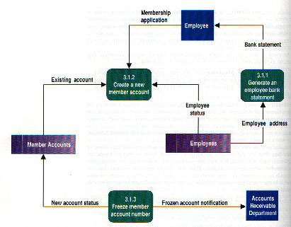
DFD – Common Errors
Black Hole
Gray Hole
Miracle

Slide 31
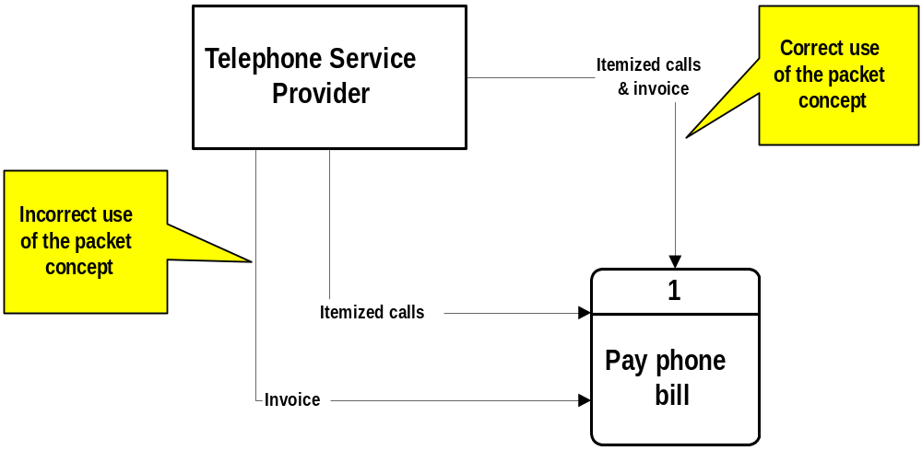
DFD – Packet Concept

Slide 32
Level 1 Tips
Generally move from top to bottom, left to right
Minimize crossed lines
Iterate as needed
  The DFD is often drawn many times before it is finished, even with very experienced systems analysts

Slide 33
Tips for Level 2 and Below
Sources for inputs and outputs listed at higher level
List source and destination of data flows to processes and stores within each DFD
Depth of DFD depends on overall system complexity
  Two processes generally don’t need lower level
  More than seven processes become overly complex and difficult to read

Slide 34
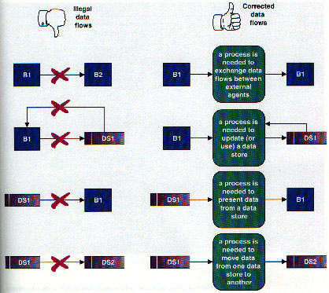
Illegal Data Flows

Slide 35
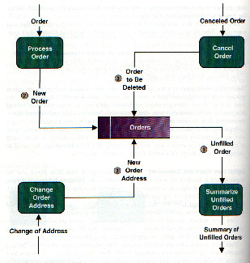
Flows to & from Data Stores

Slide 36
Data Flow Diagramming Rules
Processes
  a process must have at least one input
  a process must have at least one output
  a process name (except for the context level process) should be a verb phrase
  usually three words: verb, modifier, noun

Slide 37
Data Flow Diagramming Rules
Data stores and sources/sinks
  no data flows between two data stores; must be a process in between
  no data flows between a data store and a source or sink; must be a process in between
  no data flows between two sources/sinks

Slide 38
Data Flow Diagramming Rules
Data flows
  data flows are unidirectional
  a data flow may fork, delivering exactly the same data to two different destinations
  two data flows may join to form one only if the original two are exactly the same
  no recursive data flows
  data flows (and data stores and sources/sinks) are labeled with noun phrases
  The inputs to a process are different from the outputs
  Every object in a DFD has a unique name
  A data flow at one level may be decomposed at a lower level
  All data coming into and out of a process must be accounted for
  On low-level DFDs, new data flows can be added to represent exceptional situations

Slide 39
Simple Guidelines
the level 0 data flow diagram should depict the software/system as a single bubble
primary input and output should be carefully noted
refinement should begin by isolation candidate processes, data objects, and stores to be represented at the next level
all arrows and bubbles should be labeled with meaningful names
information flow continuity should must be maintained from level to level
one bubble at a time should be refined.

Slide 40
Examples
2.0
2.0
Total
Records
Total
Sales
Records
BETTER

Slide 41
Examples
2.1
2.1
Store
Customer
Data
Customer
Information
Store
Customer
Data
Customer
Data
Customer
Data
D1
Customer Data
D1
Customer Data
Customer
Data
2.2
Extract
Customer
Preferences
Customer
Preferences
Customer
Preferences
D2
Customer Preferences
D2
Customer Preferences

Slide 42
Examples
1.0
1.0
Take
Customer
Order
Take
Customer
Order
Customer
Order
Order
Total
Order
Information
Order
Total
Order
Information
2.0
3.0
2.0
3.0
Total
Daily
Sales
Print Delivery Instructions
Total
Daily
Sales
Print Delivery Instructions

Slide 43
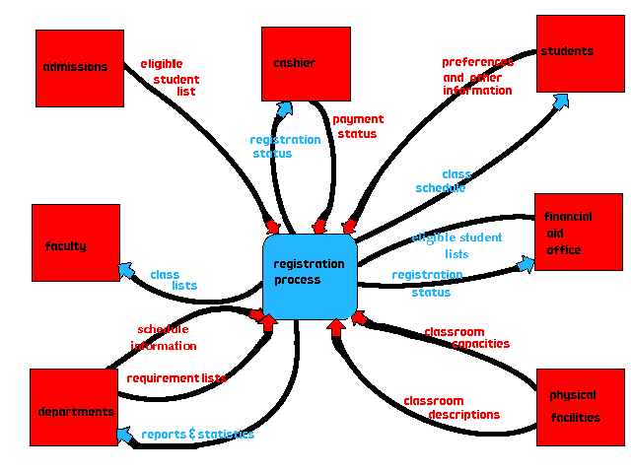
Example :To demonstrate the flows of information for the registration process. The first of these is the context diagram.

Slide 44
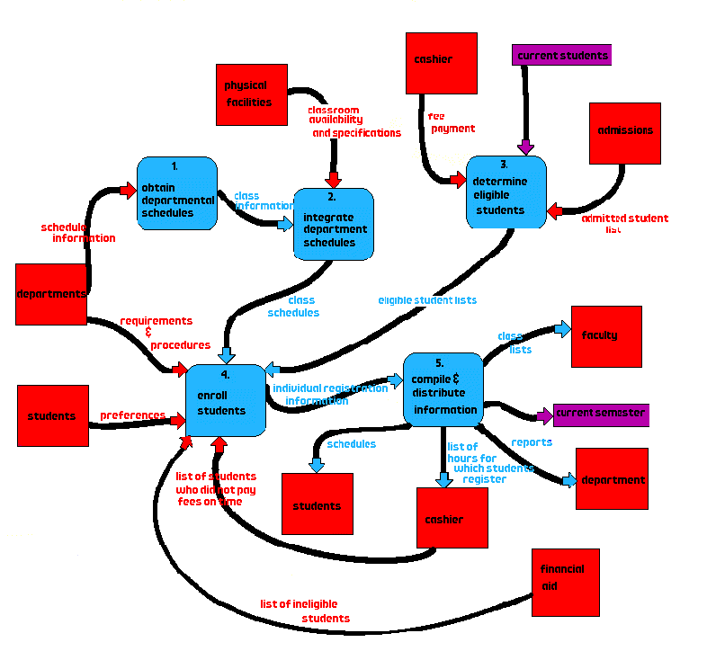
Level 1 Diagram

Slide 45
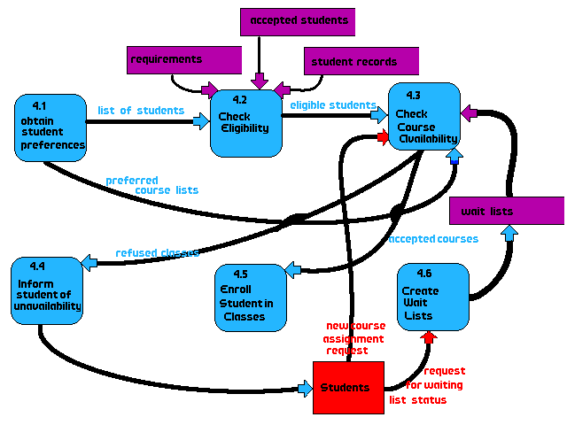
Explosion of Process 4, Enroll Students.

Slide 46
Validating the DFD
Syntax errors
  Assure correct DFD structure
Semantics errors
  Assure accuracy of DFD relative to actual/desired business processes
User walkthroughs
Role-play processes
Examine lowest level DFDs
Examine names carefully

Slide 47
How should we gather requirements? Use cases?
Use cases hold functional requirements in an easy-to-read text format
They make a good framework for non-functional requirements & project details.
Use cases show only the Functional requirements.

Slide 48
Summary
The Data Flow Diagram (DFD) is an essential tool for creating formal descriptions of business processes and data flows.
Use cases record the input, transformation, and output of business processes.
Eliciting scenario descriptions and modeling business processes are critically important skills for the systems analyst to master.

